Slide 1
Multinomial Regression
Dr. Upender Subramanian
MKT/BUAN 6337

Slide 2
Suppose You Needed to Model
Brand Choice: Which of many brands will a shopper buy?
As function of prices, promotions
Data: Brand a consumer bought on past purchase occasions
Customer Satisfaction: What rating will a customer assign?
As a function of price, customer and product characteristics
Data: Individual customer ratings on 1-5 scale for different products
Customer Classification: Which group does customer belong?
As a function of customer characteristics
Data: Classification of consumers and their characteristics

Slide 3
Multinomial Outcome Models
Outcome variable is several categorical levels
Could be ordered or unordered
Model could be for:
Predict probability of each outcome
Classification (prediction) into a particular outcome level

Slide 4
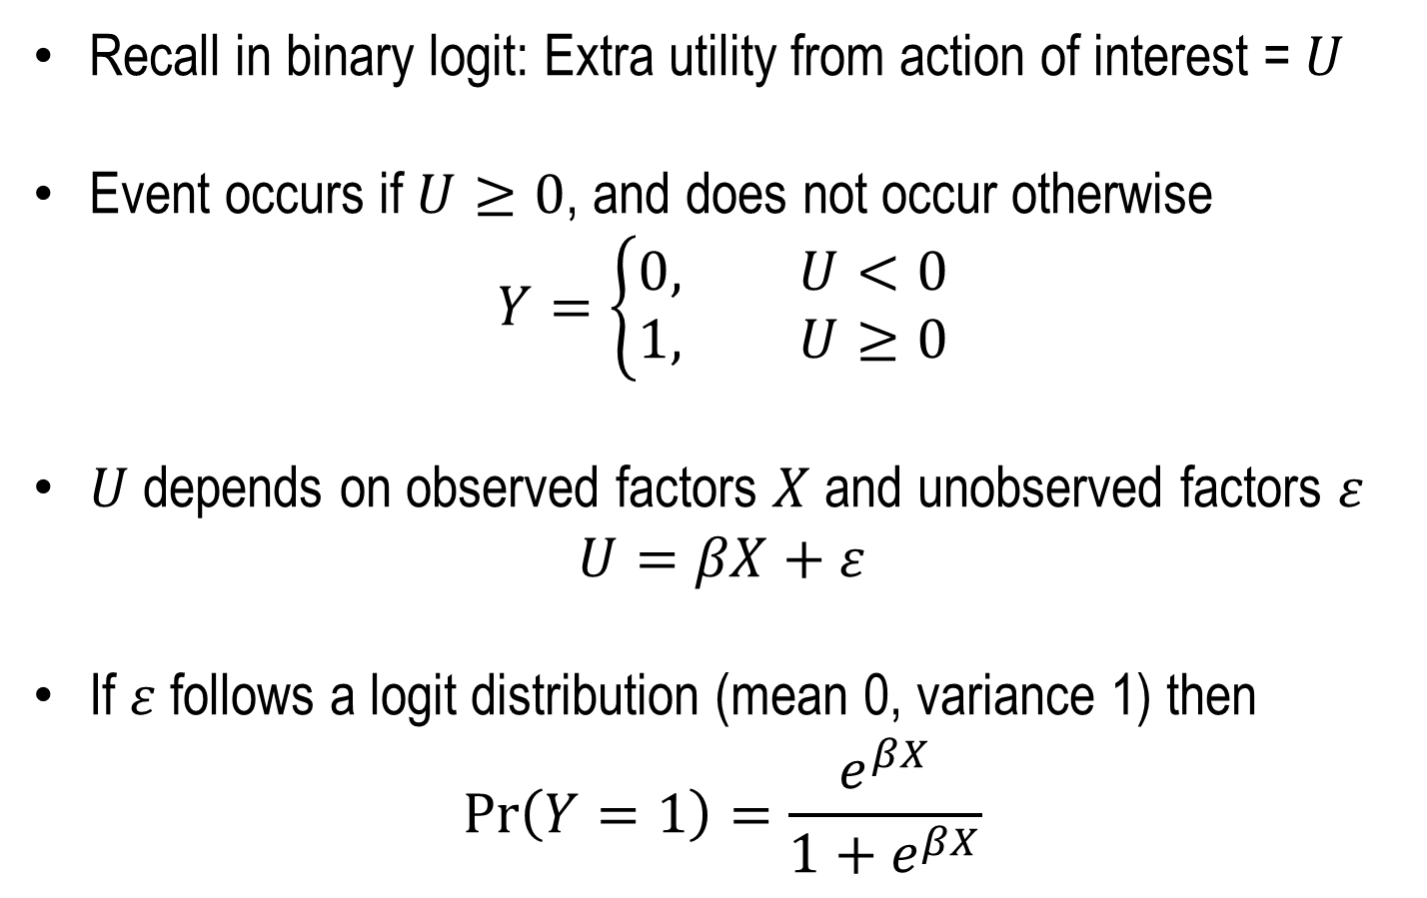
Basic Idea: Generalizing Binary Logit
Recall in binary logit: Extra utility from action of interest = $U$
Event occurs if $U≥0$, and does not occur otherwise
$$Y=\left\{\begin{aligned}0, U<0 \\ &1, U≥0\end{aligned}\right.$$
$U$ depends on observed factors $X$ and unobserved factors $ε$
$$U=βX+ε$$
If $ε$ follows a logit distribution (mean 0, variance 1) then
$$\operatorname{Pr}\left(Y=1\right)=\frac{e^{βX}}{1+e^{βX}}$$

Slide 5
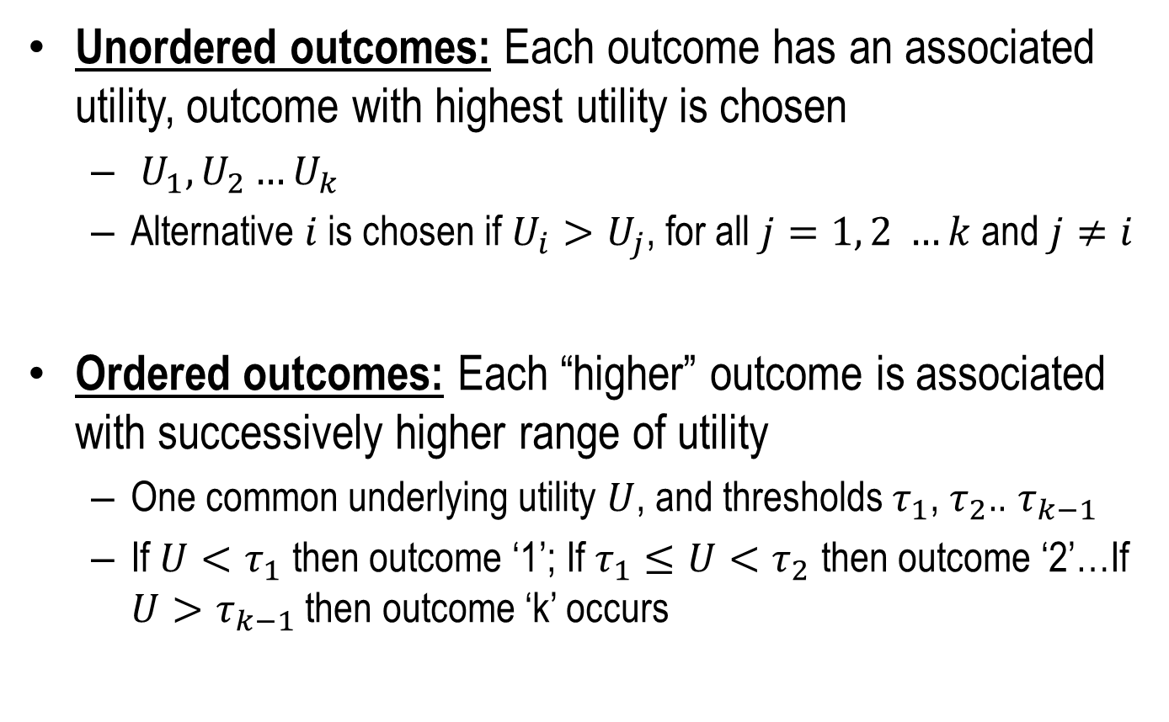
Basic Idea: Generalizing Binary Logit
Unordered outcomes: Each outcome has an associated utility, outcome with highest utility is chosen
$U_{1},U_{2}…U_{k}$
Alternative $i$ is chosen if $U_{i}>U_{j}$, for all $j=1, 2 …k$ and $j≠i$
Ordered outcomes: Each “higher” outcome is associated with successively higher range of utility
One common underlying utility $U$, and thresholds $τ_{1}$, $τ_{2}$.. $τ_{k−1}$
If $U<τ_{1}$ then outcome ‘1’; If $τ_{1}≤U<τ_{2}$ then outcome ‘2’…If $U>τ_{k−1}$ then outcome ‘k’ occurs

Slide 6
Unordered Multinomial Regression

Slide 7
Brand Choice Example
Shopping data: Coke / Pepsi / 7up brand choice with price, display and feature at time of purchase
Alternative characteristics
For each choice occasion
Alternative
id | choice | price | feature | display | soda
1 | 0 | 1.79 | 0 | 0 | Pepsi
1 | 0 | 1.79 | 0 | 0 | 7up
1 | 1 | 1.79 | 0 | 0 | Coke
2 | 0 | 1.79 | 0 | 0 | Pepsi
2 | 0 | 1.79 | 0 | 0 | 7up
2 | 1 | 0.89 | 1 | 1 | Coke
3 | 0 | 1.41 | 0 | 0 | Pepsi
3 | 0 | 0.84 | 0 | 1 | 7up
3 | 1 | 0.89 | 1 | 0 | Coke
One choice Occasion
One choice Occasion
One choice Occasion

Slide 8
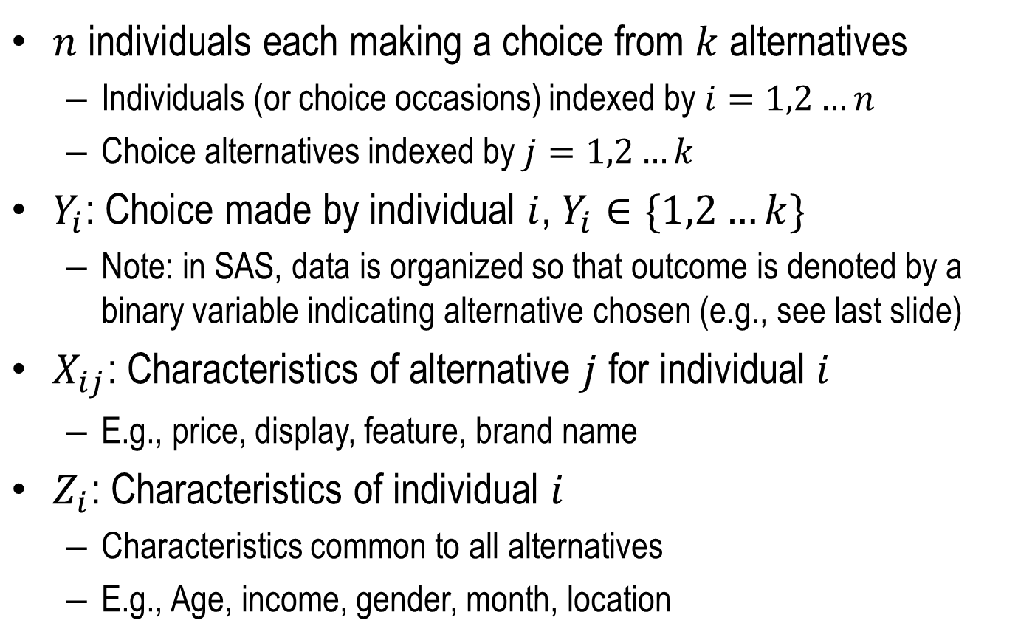
Multinomial Model Formulation
$n$ individuals each making a choice from $k$ alternatives
Individuals (or choice occasions) indexed by $i=1,2…n$
Choice alternatives indexed by $j=1,2…k$
$Y_{i}$: Choice made by individual $i$, $Y_{i}∈\{1,2…k\}$
Note: in SAS, data is organized so that outcome is denoted by a binary variable indicating alternative chosen (e.g., see last slide)
$X_{ij}$: Characteristics of alternative $j$ for individual $i$
E.g., price, display, feature, brand name
$Z_{i}$: Characteristics of individual $i$
Characteristics common to all alternatives
E.g., Age, income, gender, month, location

Slide 9
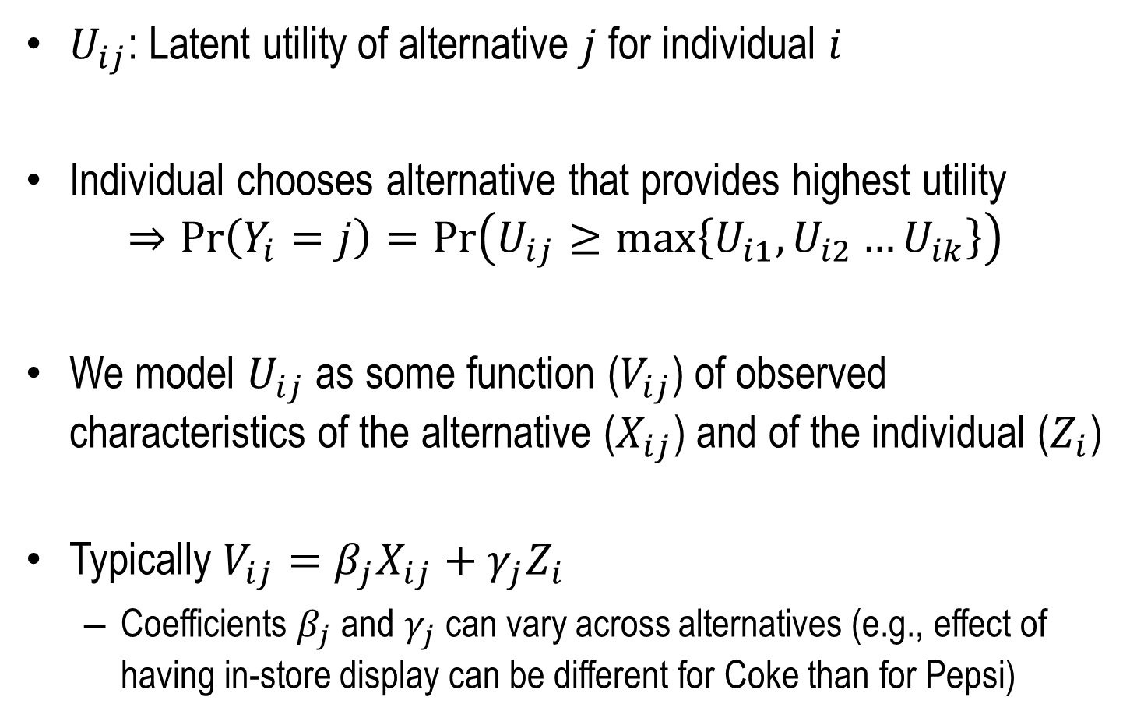
Multinomial Model Formulation
$U_{ij}$: Latent utility of alternative $j$ for individual $i$
Individual chooses alternative that provides highest utility
$$⇒\operatorname{Pr}\left(Y_{i}=j\right)=\operatorname{Pr}\left(U_{ij}≥\max\left\{U_{i1},U_{i2}…U_{ik}\right\}\right)$$
We model $U_{ij}$ as some function ($V_{ij}$) of observed characteristics of the alternative ($X_{ij}$) and of the individual ($Z_{i}$)
Typically $V_{ij}=β_{j}X_{ij}+γ_{j}Z_{i}$
Coefficients $β_{j}$ and $γ_{j}$ can vary across alternatives (e.g., effect of having in-store display can be different for Coke than for Pepsi)

Slide 10
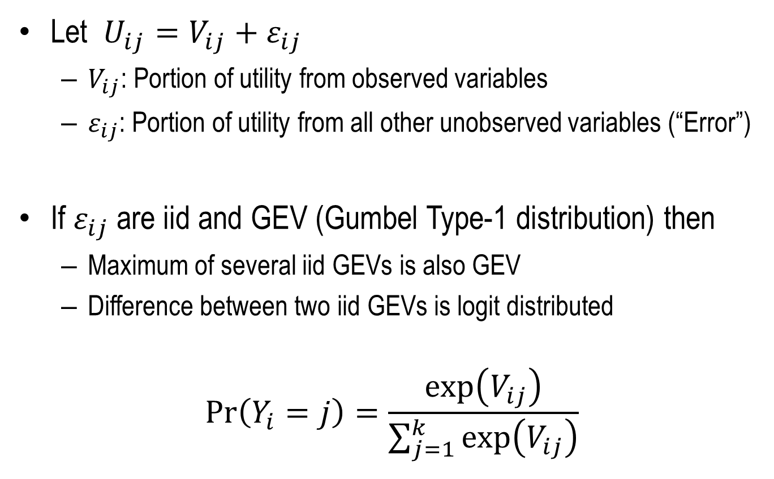
Multinomial Model Formulation
Let $U_{ij}=V_{ij}+ε_{ij}$
$V_{ij}$: Portion of utility from observed variables
$ε_{ij}$: Portion of utility from all other unobserved variables (“Error”)
If $ε_{ij}$ are iid and GEV (Gumbel Type-1 distribution) then
Maximum of several iid GEVs is also GEV
Difference between two iid GEVs is logit distributed
$$\operatorname{Pr}\left(Y_{i}=j\right)=\frac{\exp\left(V_{ij}\right)}{\sum_{j=1}^{k}{\exp\left(V_{ij}\right)}}$$

Slide 11
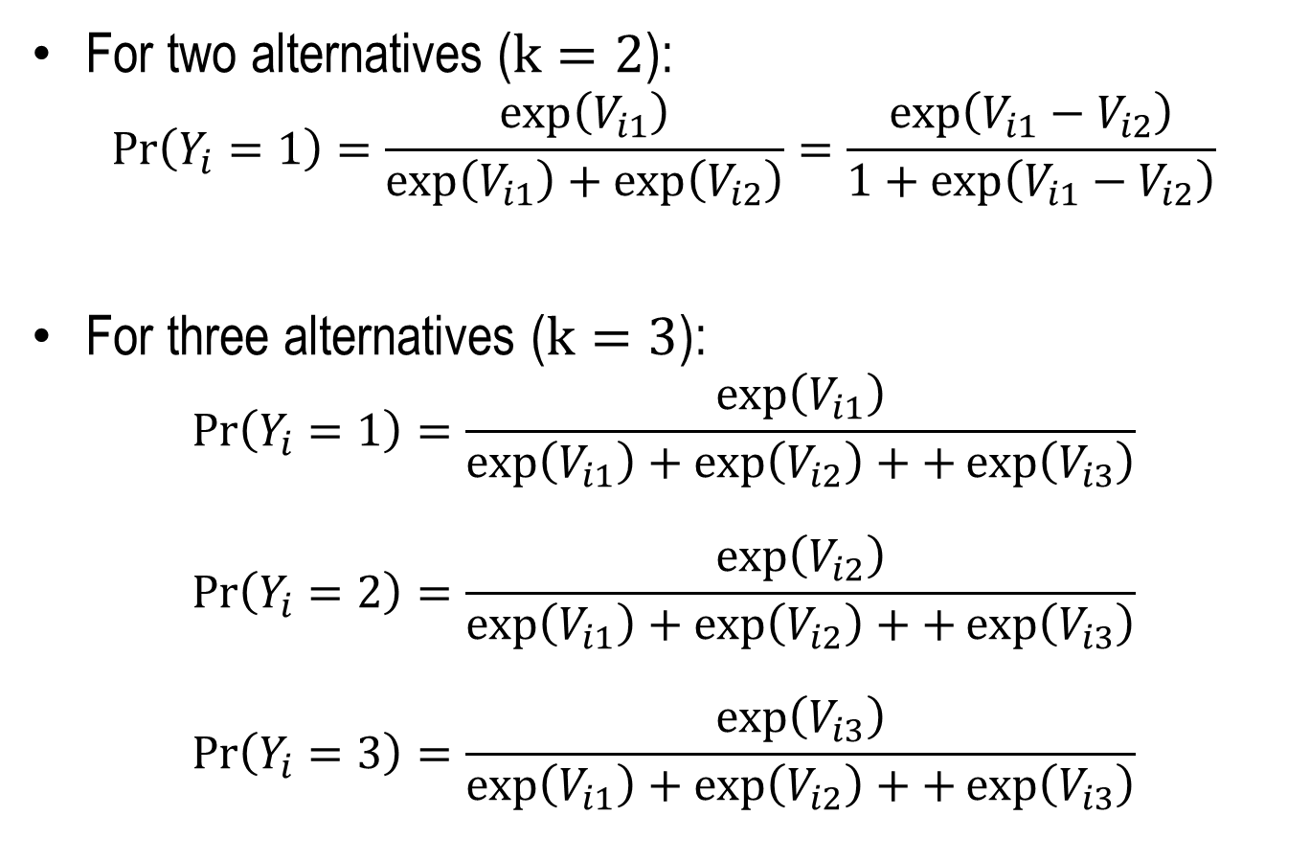
Multinomial Model Formulation
For two alternatives ($k=2$):
$$\operatorname{Pr}\left(Y_{i}=1\right)=\frac{\exp\left(V_{i1}\right)}{\exp\left(V_{i1}\right)+\exp\left(V_{i2}\right)}=\frac{\exp\left(V_{i1}−V_{i2}\right)}{1+\exp\left(V_{i1}−V_{i2}\right)}$$
For three alternatives ($k=3$):
$$\operatorname{Pr}\left(Y_{i}=1\right)=\frac{\exp\left(V_{i1}\right)}{\exp\left(V_{i1}\right)+\exp\left(V_{i2}\right)++\exp\left(V_{i3}\right)}$$
$$\operatorname{Pr}\left(Y_{i}=2\right)=\frac{\exp\left(V_{i2}\right)}{\exp\left(V_{i1}\right)+\exp\left(V_{i2}\right)++\exp\left(V_{i3}\right)}$$
$$\operatorname{Pr}\left(Y_{i}=3\right)=\frac{\exp\left(V_{i3}\right)}{\exp\left(V_{i1}\right)+\exp\left(V_{i2}\right)++\exp\left(V_{i3}\right)}$$

Slide 12
Brand Choice Example
Shopping data: Coke / Pepsi / 7up brand choice with price, display and feature at time of purchase
No individual-specific observable effects, only alternative characteristics (price, feature, display)
Alternative characteristics
For each choice occasion
Alternative
id | choice | price | feature | display | soda
1 | 0 | 1.79 | 0 | 0 | Pepsi
1 | 0 | 1.79 | 0 | 0 | 7up
1 | 1 | 1.79 | 0 | 0 | Coke
2 | 0 | 1.79 | 0 | 0 | Pepsi
2 | 0 | 1.79 | 0 | 0 | 7up
2 | 1 | 0.89 | 1 | 1 | Coke
3 | 0 | 1.41 | 0 | 0 | Pepsi
3 | 0 | 0.84 | 0 | 1 | 7up
3 | 1 | 0.89 | 1 | 0 | Coke
One choice Occasion
One choice Occasion
One choice Occasion

Slide 13
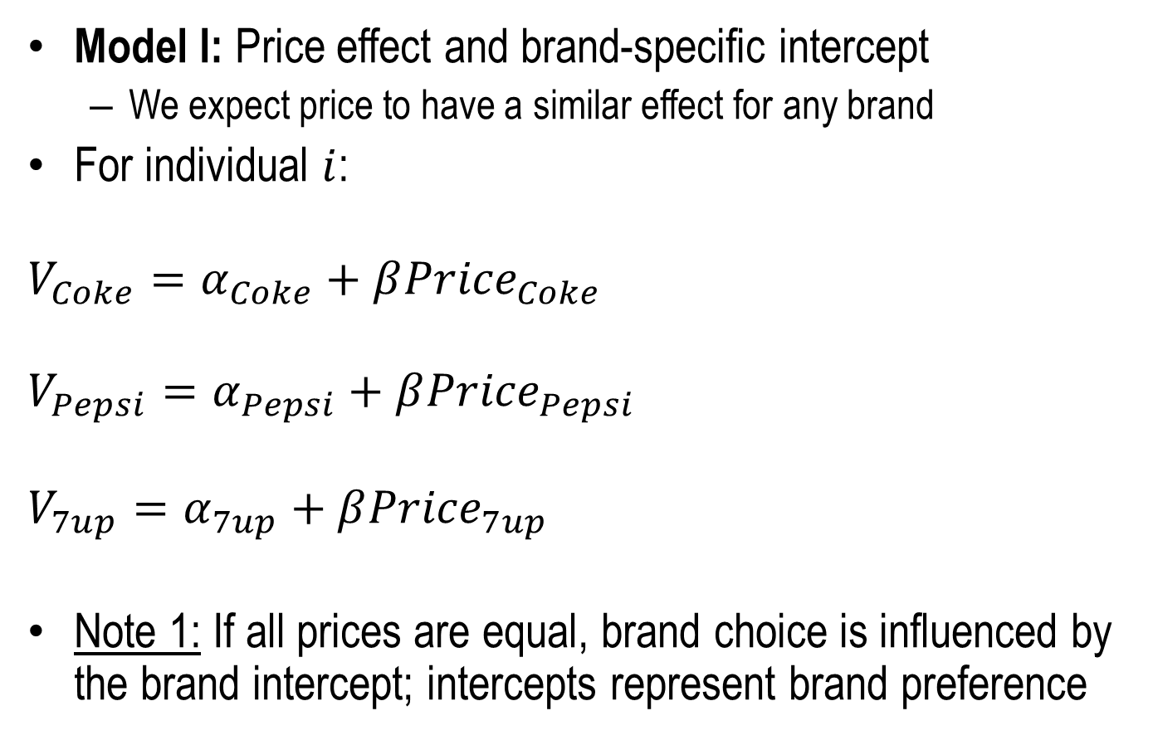
Brand Choice Example
Model I: Price effect and brand-specific intercept
We expect price to have a similar effect for any brand
For individual $i$:
$$V_{Coke}=α_{Coke}+β{Price}_{Coke}$$
$$V_{Pepsi}=α_{Pepsi}+β{Price}_{Pepsi}$$
$$V_{7up}=α_{7up}+β{Price}_{7up}$$
Note 1: If all prices are equal, brand choice is influenced by the brand intercept; intercepts represent brand preference

Slide 14
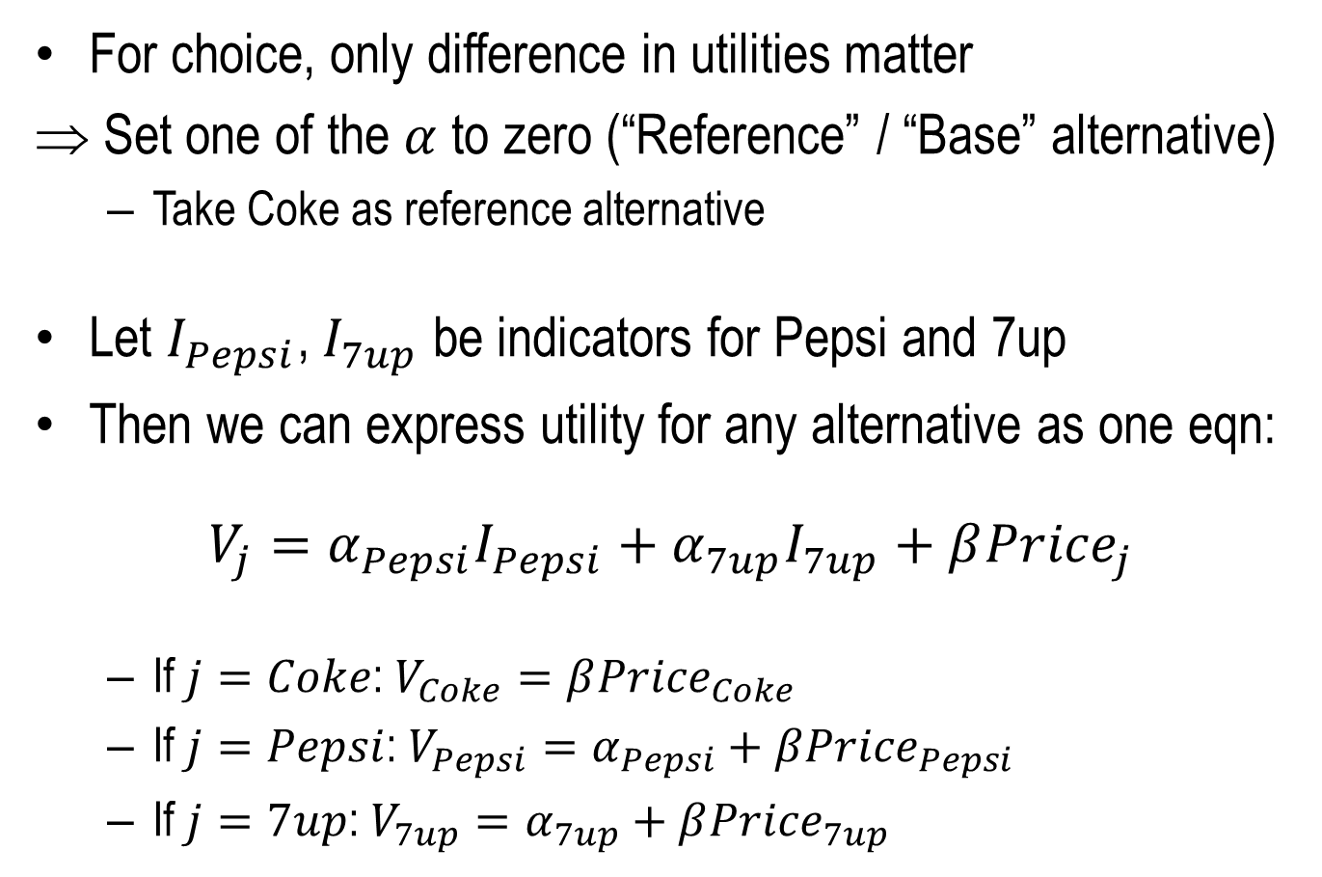
Brand Choice Example
For choice, only difference in utilities matter
Set one of the $α$ to zero (“Reference” / “Base” alternative)
Take Coke as reference alternative
Let $I_{Pepsi}$, $I_{7up}$ be indicators for Pepsi and 7up
Then we can express utility for any alternative as one eqn:
$$V_{j}=α_{Pepsi}I_{Pepsi}+α_{7up}I_{7up}+β{Price}_{j}$$
If $j=Coke$: $V_{Coke}=β{Price}_{Coke}$
If $j=Pepsi$: $V_{Pepsi}=α_{Pepsi}+β{Price}_{Pepsi}$
If $j=7up$: $V_{7up}=α_{7up}+β{Price}_{7up}$

Slide 15
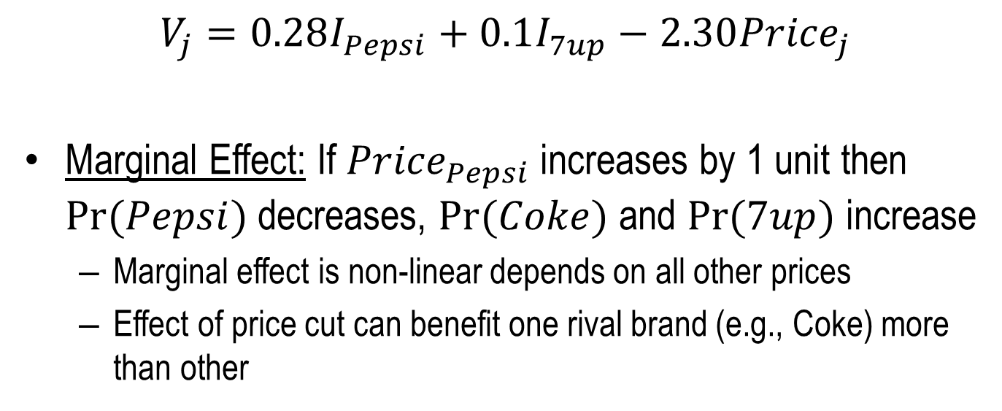
Model Estimates
Parameter |  | DF | Estimate | Standard Error | Wald Chi-Sq | Pr > ChiSq
soda | 7up | 1 | 0.1038 | 0.0625 | 2.7626 | 0.0965
soda | Pepsi | 1 | 0.2832 | 0.0624 | 20.6053 | <.0001
price |  | 1 | -2.2964 | 0.1377 | 278.2808 | <.0001
$$V_{j}=0.28I_{Pepsi}+0.1I_{7up}−2.30{Price}_{j}$$
Marginal Effect: If ${Price}_{Pepsi}$ increases by 1 unit then $Pr⁡(Pepsi)$ decreases, $Pr⁡(Coke)$ and $Pr⁡(7up)$ increase
Marginal effect is non-linear depends on all other prices
Effect of price cut can benefit one rival brand (e.g., Coke) more than other

Slide 16
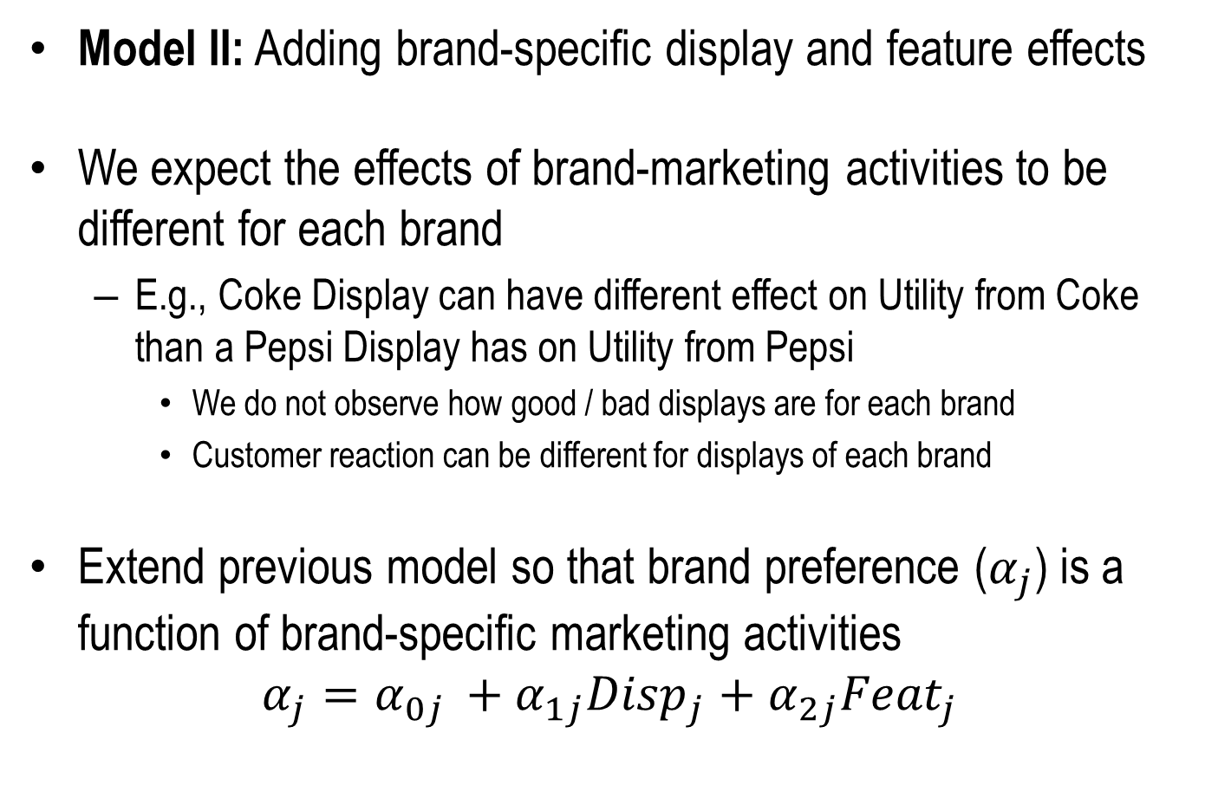
Brand Choice Example
Model II: Adding brand-specific display and feature effects
We expect the effects of brand-marketing activities to be different for each brand
E.g., Coke Display can have different effect on Utility from Coke than a Pepsi Display has on Utility from Pepsi
We do not observe how good / bad displays are for each brand
Customer reaction can be different for displays of each brand
Extend previous model so that brand preference ($α_{j}$) is a function of brand-specific marketing activities
$$α_{j}=α_{0j }+α_{1j}{Disp}_{j}+α_{2j}{Feat}_{j}$$

Slide 17
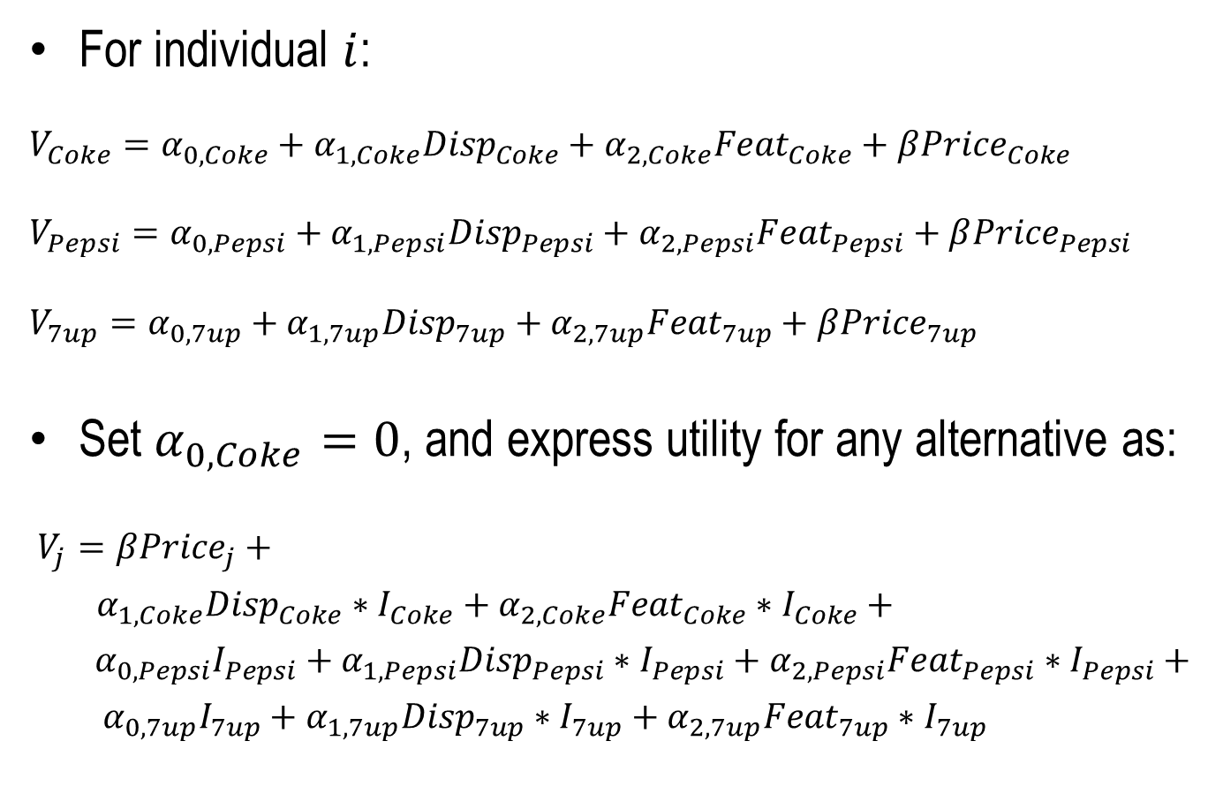
Brand Choice Example
For individual $i$:
$$V_{Coke}=α_{0,Coke}+α_{1,Coke}{Disp}_{Coke}+α_{2,Coke}{Feat}_{Coke}+β{Price}_{Coke}$$
$$V_{Pepsi}=α_{0,Pepsi}+α_{1,Pepsi}{Disp}_{Pepsi}+α_{2,Pepsi}{Feat}_{Pepsi}+β{Price}_{Pepsi}$$
$$V_{7up}=α_{0,7up}+α_{1,7up}{Disp}_{7up}+α_{2,7up}{Feat}_{7up}+β{Price}_{7up}$$
Set $α_{0,Coke}=0$, and express utility for any alternative as:
$V_{j}=β{Price}_{j}+$
$α_{1,Coke}{Disp}_{Coke}∗I_{Coke}+α_{2,Coke}{Feat}_{Coke}∗I_{Coke}+$
$α_{0,Pepsi}I_{Pepsi}+α_{1,Pepsi}{Disp}_{Pepsi}∗I_{Pepsi}+α_{2,Pepsi}{Feat}_{Pepsi}∗I_{Pepsi}+$
$α_{0,7up}I_{7up}+α_{1,7up}{Disp}_{7up}∗I_{7up}+α_{2,7up}{Feat}_{7up}∗I_{7up}$

Slide 18
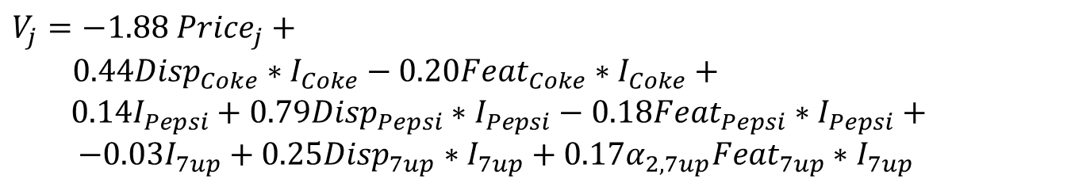
Brand Choice Example
Parameter |  | DF | Estimate | Standard Error | Wald Chi-Sq | Pr > ChiSq
price |  | 1 | -1.8751 | 0.1892 | 98.2189 | <.0001
soda | 7up | 1 | -0.0279 | 0.1105 | 0.0639 | 0.8005
soda | Pepsi | 1 | 0.1442 | 0.1094 | 1.7362 | 0.1876
soda | Coke | 0 | 0 | . | . | .
display*soda | 7up | 1 | 0.2536 | 0.1265 | 4.0171 | 0.0450
display*soda | Pepsi | 1 | 0.7906 | 0.1447 | 29.8719 | <.0001
display*soda | Coke | 1 | 0.4379 | 0.1371 | 10.1968 | 0.0014
feature*soda | 7up | 1 | 0.1683 | 0.1251 | 1.8093 | 0.1786
feature*soda | Pepsi | 1 | -0.1763 | 0.1422 | 1.5370 | 0.2151
feature*soda | Coke | 1 | -0.1974 | 0.1360 | 2.1072 | 0.1466
$$V_{j}=−1.88 {Price}_{j}+$$
$0.44{Disp}_{Coke}∗I_{Coke}−0.20{Feat}_{Coke}∗I_{Coke}+$
$0.14I_{Pepsi}+0.79{Disp}_{Pepsi}∗I_{Pepsi}−0.18{Feat}_{Pepsi}∗I_{Pepsi}+$
$−0.03I_{7up}+0.25{Disp}_{7up}∗I_{7up}+0.17α_{2,7up}{Feat}_{7up}∗I_{7up}$

Slide 19
Transportation Choice Example
People can choose to travel by plane, car or public transit
The travel time for each alternative varies depending on the origin and destination cities (alternative characteristic)
We would like to analyze whether traveler’s age affects the choice of mode of travel (individual characteristic)
Utility from a particular mode of transport can differ by age
Age differs across individuals, not across alternatives for that individual

Slide 20
Transportation Choice Example
Customer Characteristic
Alternative Chosen
Alternative Characteristics
Obs | AutoTime | PlanTime | TranTime | Age | Chosen
1 | 10.0 | 4.5 | 10.5 | 32 | Plane
2 | 5.5 | 4.0 | 7.5 | 13 | Auto
3 | 4.5 | 6.0 | 5.5 | 41 | Transit
4 | 3.5 | 2.0 | 5.0 | 41 | Transit
5 | 1.5 | 4.5 | 4.0 | 47 | Auto
Each observation is for one individual / choice occasion

Slide 21
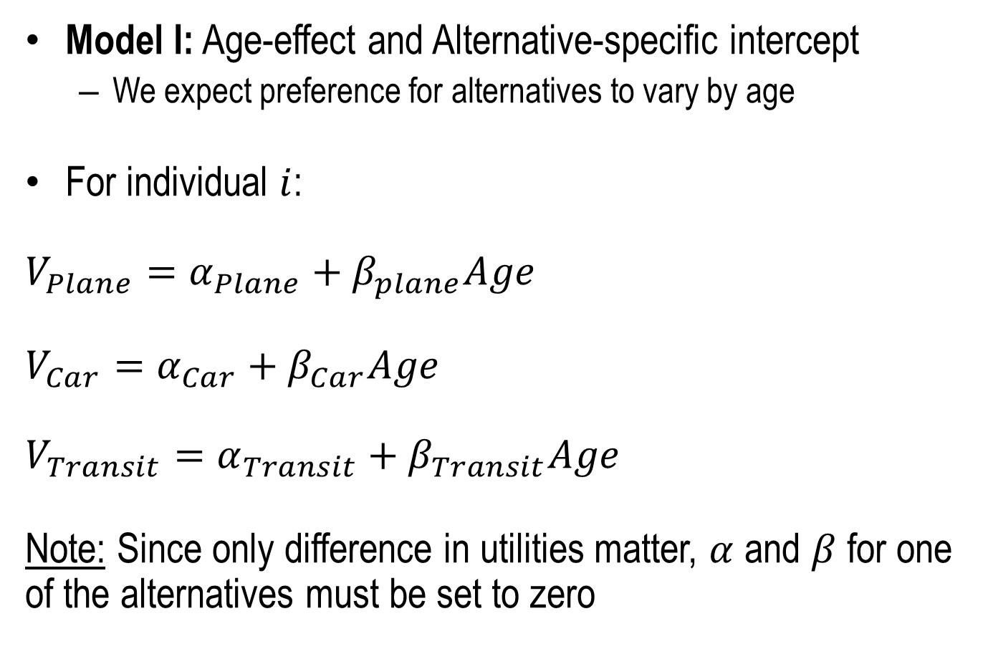
Transportation Choice Example
Model I: Age-effect and Alternative-specific intercept
We expect preference for alternatives to vary by age
For individual $i$:
$$V_{Plane}=α_{Plane}+β_{plane}Age$$
$$V_{Car}=α_{Car}+β_{Car}Age$$
$$V_{Transit}=α_{Transit}+β_{Transit}Age$$
Note: Since only difference in utilities matter, $α$ and $β$ for one of the alternatives must be set to zero

Slide 22
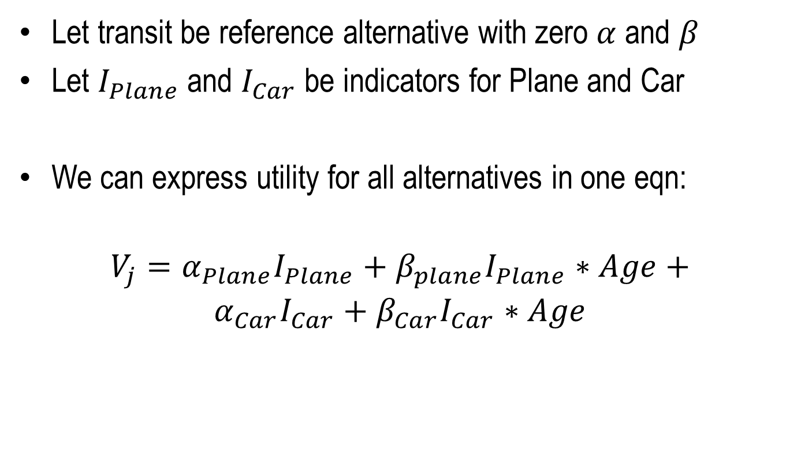
Transportation Choice Example
Let transit be reference alternative with zero $α$ and $β$
Let $I_{Plane}$ and $I_{Car}$ be indicators for Plane and Car
We can express utility for all alternatives in one eqn:
$$V_{j}=α_{Plane}I_{Plane}+β_{plane}I_{Plane}∗Age+$$
$$α_{Car}I_{Car}+β_{Car}I_{Car}∗Age$$

Slide 23
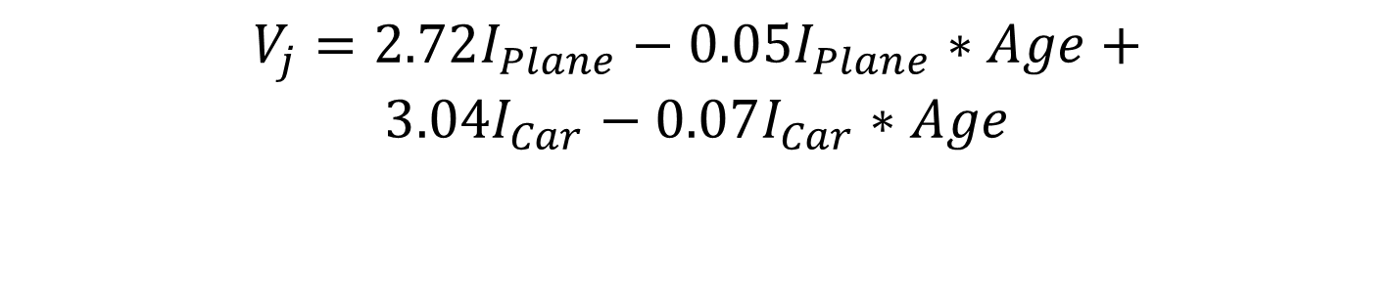
Transportation Choice Example
Parameter | Chosen | DF | Estimate | Standard Error | Wald Chi-Sq | Pr > ChiSq
Intercept | Auto | 1 | 3.0449 | 2.4268 | 1.5743 | 0.2096
Intercept | Plane | 1 | 2.7212 | 2.2929 | 1.4085 | 0.2353
Age | Auto | 1 | -0.0710 | 0.0652 | 1.1859 | 0.2762
Age | Plane | 1 | -0.0500 | 0.0596 | 0.7044 | 0.4013
$$V_{j}=2.72I_{Plane}−0.05I_{Plane}∗Age+$$
$$3.04I_{Car}−0.07I_{Car}∗Age$$

Slide 24
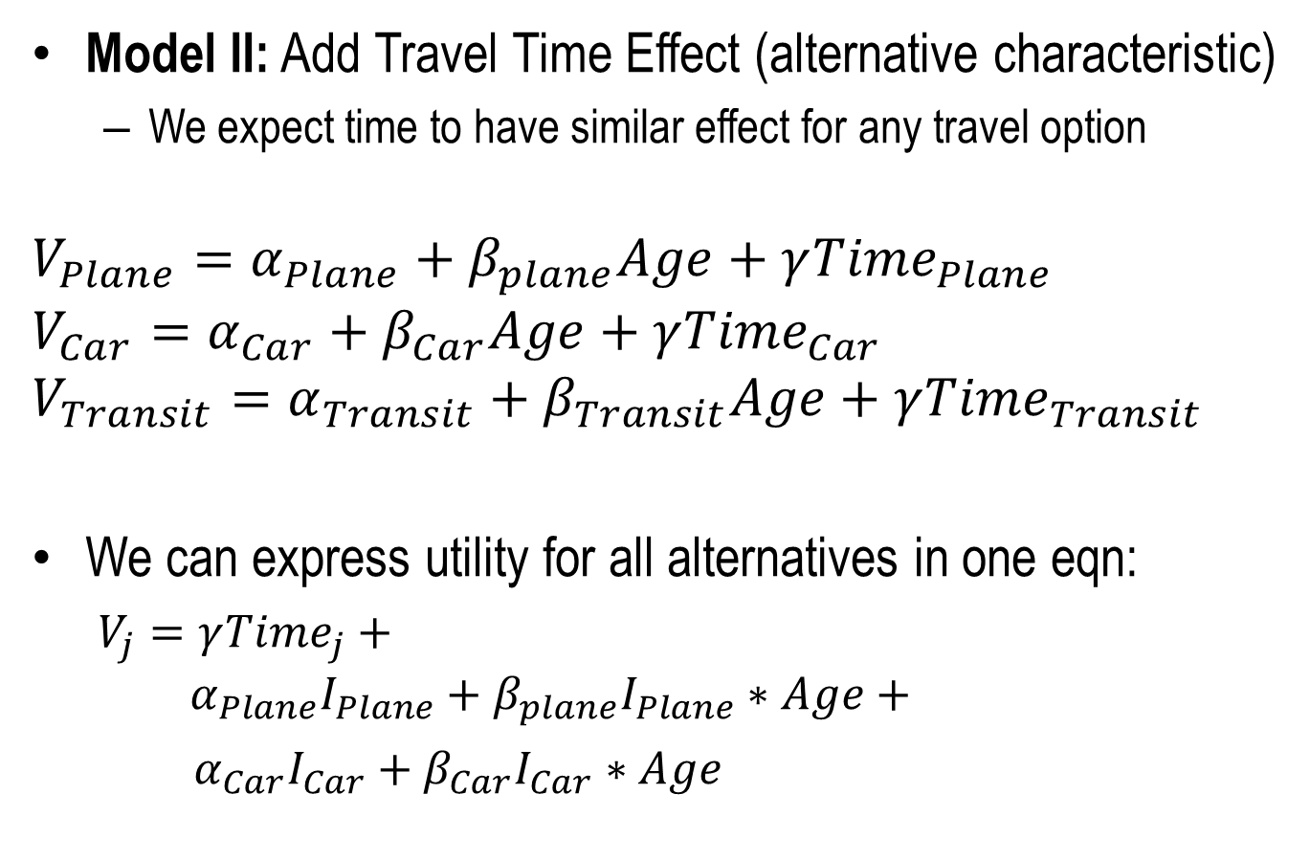
Transportation Choice Example
Model II: Add Travel Time Effect (alternative characteristic)
We expect time to have similar effect for any travel option
$$V_{Plane}=α_{Plane}+β_{plane}Age+γ{Time}_{Plane}$$
$$V_{Car}=α_{Car}+β_{Car}Age+γ{Time}_{Car}$$
$$V_{Transit}=α_{Transit}+β_{Transit}Age+γ{Time}_{Transit}$$
We can express utility for all alternatives in one eqn:
$V_{j}=γ{Time}_{j}+$
$$α_{Plane}I_{Plane}+β_{plane}I_{Plane}∗Age+$$
$α_{Car}I_{Car}+β_{Car}I_{Car}∗Age$

Slide 25
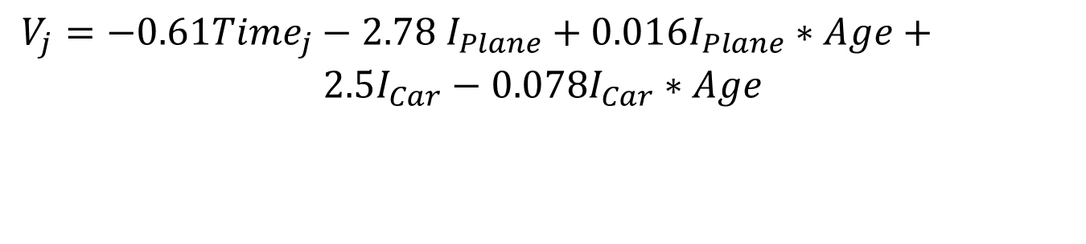
Transportation Choice Example
Parameter |  | DF | Estimate | Standard Error | Wald Chi-Sq | Pr > ChiSq
Mode | Auto | 1 | 2.5007 | 2.3959 | 1.0894 | 0.2966
Mode | Plane | 1 | -2.7792 | 3.5293 | 0.6201 | 0.4310
Age*Mode | Auto | 1 | -0.0783 | 0.0633 | 1.5274 | 0.2165
Age*Mode | Plane | 1 | 0.0169 | 0.0744 | 0.0519 | 0.8198
TravTime |  | 1 | -0.6085 | 0.2713 | 5.0315 | 0.0249
$V_{j}=−0.61{Time}_{j}−2.78 I_{Plane}+0.016I_{Plane}∗Age+$
$$2.5I_{Car}−0.078I_{Car}∗Age$$

Slide 26
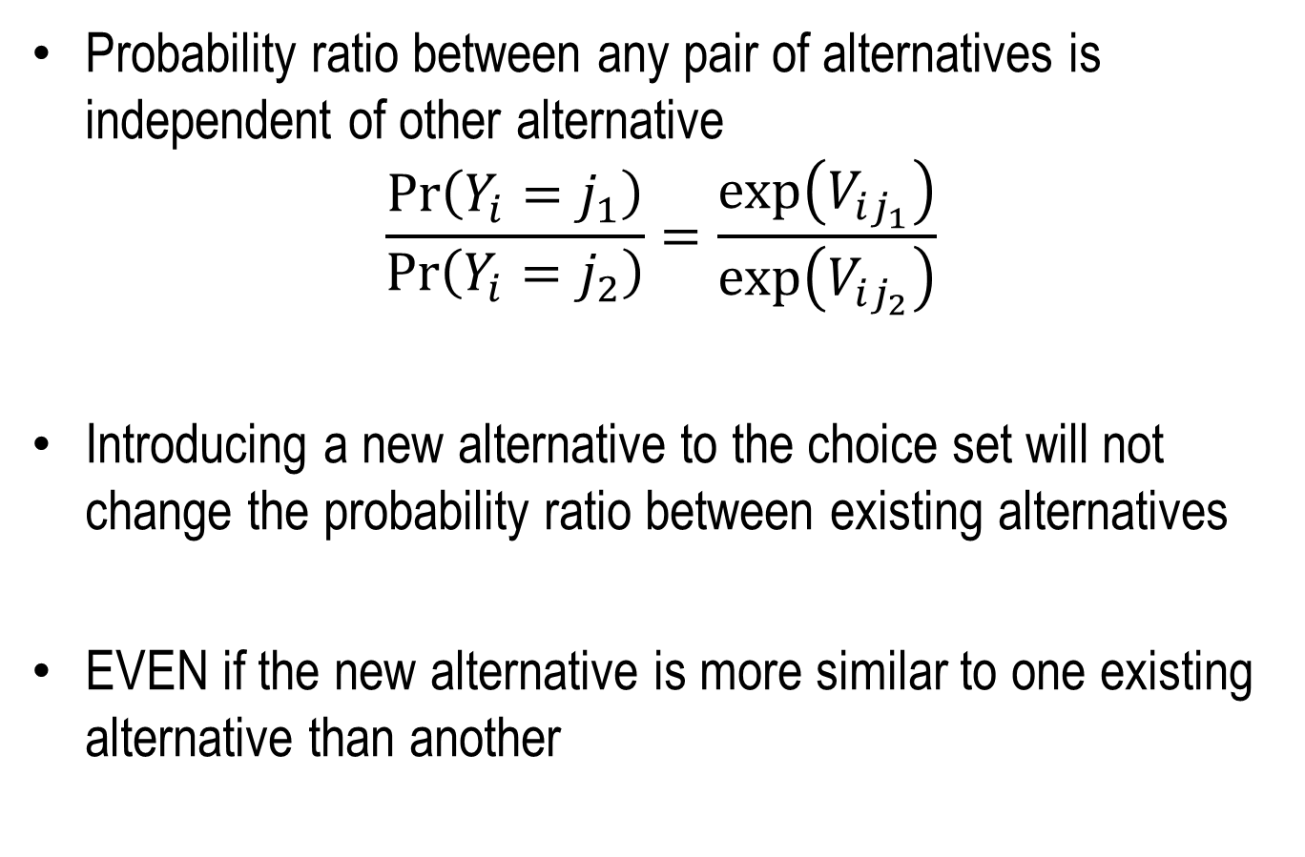
Independence of Irrelevant Alternatives (IIA)
Probability ratio between any pair of alternatives is independent of other alternative
$$\frac{\operatorname{Pr}\left(Y_{i}=j_{1}\right)}{\operatorname{Pr}\left(Y_{i}=j_{2}\right)}=\frac{\exp\left(V_{ij_{1}}\right)}{\exp\left(V_{ij_{2}}\right)}$$
Introducing a new alternative to the choice set will not change the probability ratio between existing alternatives
EVEN if the new alternative is more similar to one existing alternative than another

Slide 27
Example: Why IIA Can Be A Problem
Suppose transportation choice is between red bus and car
Introducing a blue bus to the choice set should have a larger impact on choice probability of red bus than car
Since blue bus and red bus are close substitutes
Therefore probability ratio of red bus to car should reduce
However IIA property means ratio remains the same
IIA => any new choice “steals” share in equal proportion from all existing alternatives
May not be realistic in applications where some alternatives are close substitutes

Slide 28
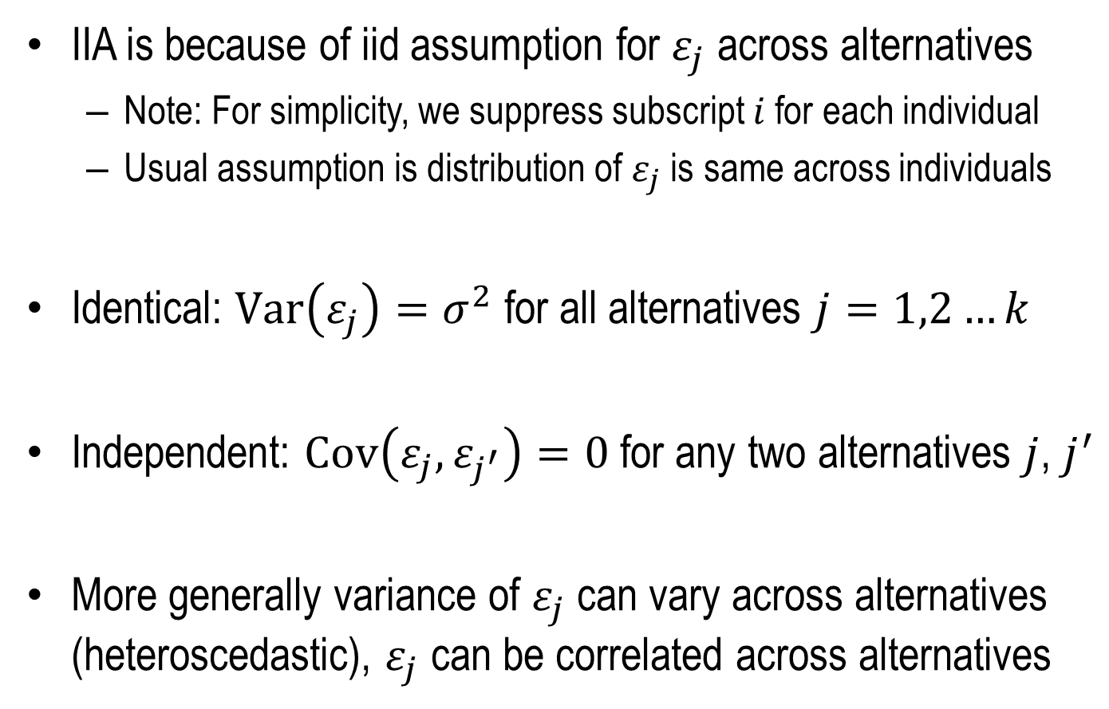
What Leads to IIA?
IIA is because of iid assumption for $ε_{j}$ across alternatives
Note: For simplicity, we suppress subscript $i$ for each individual
Usual assumption is distribution of $ε_{j}$ is same across individuals
Identical: $Var\left(ε_{j}\right)=σ^{2}$ for all alternatives $j=1,2…k$
Independent: $Cov\left(ε_{j},ε_{j^{′}}\right)=0$ for any two alternatives $j$, $j^{′}$
More generally variance of $ε_{j}$ can vary across alternatives (heteroscedastic), $ε_{j}$ can be correlated across alternatives

Slide 29
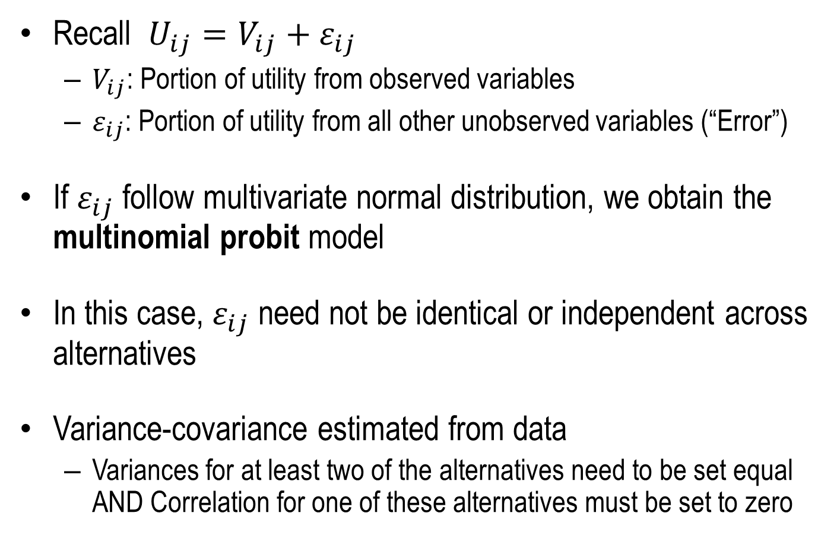
Multinomial Probit
Recall $U_{ij}=V_{ij}+ε_{ij}$
$V_{ij}$: Portion of utility from observed variables
$ε_{ij}$: Portion of utility from all other unobserved variables (“Error”)
If $ε_{ij}$ follow multivariate normal distribution, we obtain the multinomial probit model
In this case, $ε_{ij}$ need not be identical or independent across alternatives
Variance-covariance estimated from data
Variances for at least two of the alternatives need to be set equal AND Correlation for one of these alternatives must be set to zero

Slide 30
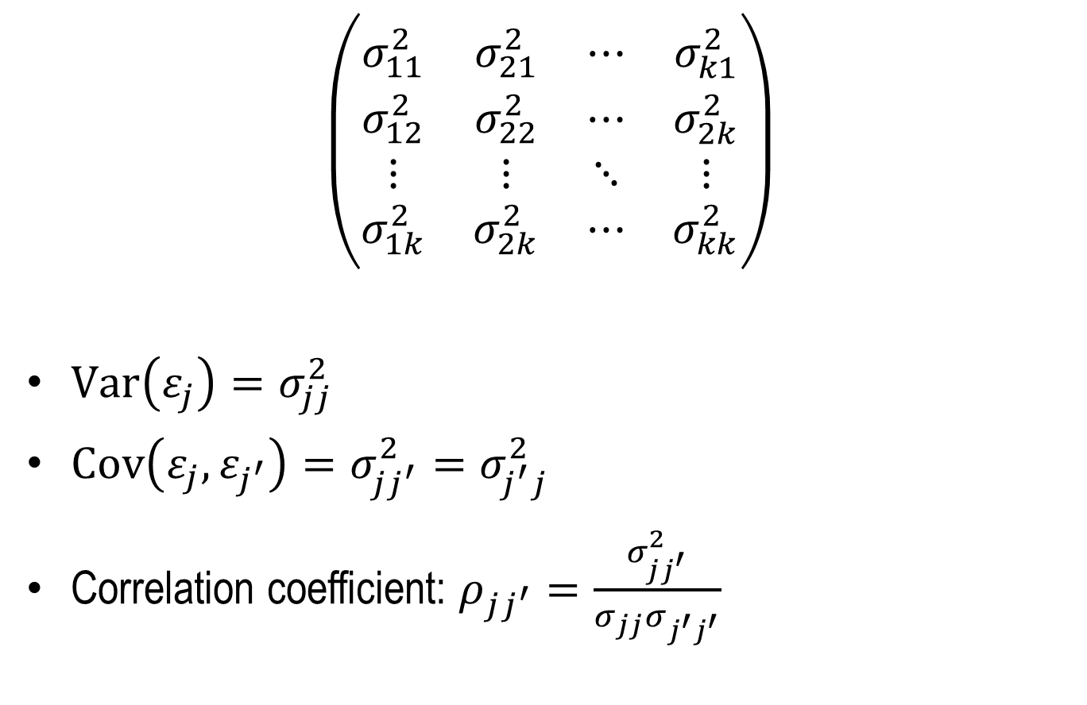
Variance – Covariance Matrix
$$\left(\begin{matrix}σ_{11}^{2} & σ_{21}^{2} & ⋯ & σ_{k1}^{2} \\ σ_{12}^{2} & σ_{22}^{2} & ⋯ & σ_{2k}^{2} \\ ⋮ & ⋮ & ⋱ & ⋮ \\ σ_{1k}^{2} & σ_{2k}^{2} & ⋯ & σ_{kk}^{2}\end{matrix}\right)$$
$Var\left(ε_{j}\right)=σ_{jj}^{2}$
$Cov\left(ε_{j},ε_{j^{′}}\right)=σ_{jj^{′}}^{2}=σ_{j^{′}j}^{2}$
Correlation coefficient: $ρ_{jj^{′}}=\frac{σ_{jj^{′}}^{2}}{σ_{jj}σ_{j^{′}j^{′}}}$

Slide 31



Brand Choice Example
3 Alternatives: Pepsi, 7up, Coke
SAS (PROC MDC) Default: Variances (of $ε$) for last two alternatives (7up,Coke) is set equal, and covariances (of $ε$) for last alternative (Coke) is set to zero
We estimate variance for pepsi and covariance for pepsi, 7up
Parameter | DF | Estimate | Standard Error | t Value | Approx Pr > |t|
SODAPepsi | 1 | 0.4519 | 0.0580 | 7.80 | <.0001
SODA7up | 1 | 0.2673 | 0.0765 | 3.49 | 0.0005
price | 1 | -1.3627 | 0.1302 | -10.47 | <.0001
STD_1 | 1 | 0.7045 | 0.2004 | 3.52 | 0.0004
RHO_21 | 1 | 0.5703 | 0.1079 | 5.28 | <.0001
$$σ_{11}$$
$$ρ_{21}$$

Slide 32
Part II: Ordered Multinomial Regression
Dr. Upender Subramanian
MKT/BUAN 6337

Slide 33
College Choice Example
psechoice | hscath | grades | faminc | famsiz | parcoll | female | black
2 | 0 | 9.08 | 62.5 | 5 | 0 | 0 | 0
2 | 0 | 8.31 | 42.5 | 4 | 0 | 1 | 0
3 | 0 | 7.42 | 62.5 | 4 | 0 | 1 | 0
3 | 0 | 7.42 | 62.5 | 4 | 0 | 1 | 0
3 | 0 | 7.42 | 62.5 | 4 | 0 | 1 | 0
3 | 0 | 7.46 | 12.5 | 2 | 0 | 1 | 0
2 | 0 | 9.67 | 30 | 5 | 0 | 0 | 0
1 | 0 | 11.77 | 42.5 | 4 | 0 | 0 | 0
3 | 0 | 8.81 | 17.5 | 3 | 0 | 1 | 0
College Choice Data
1=No college, 2=2-year college, 3=4-year college
We order alternatives as 3 > 2 > 1
We would like to see how socio-demographic background and previous educational attainment affect choice

Slide 34
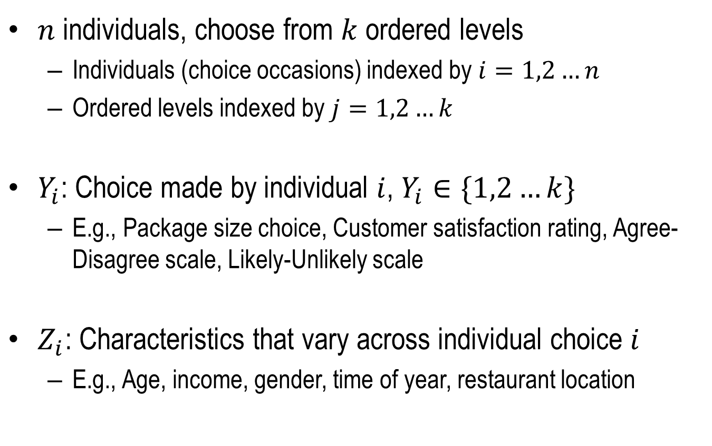
Ordered Logit Model Formulation
$n$ individuals, choose from $k$ ordered levels
Individuals (choice occasions) indexed by $i=1,2…n$
Ordered levels indexed by $j=1,2…k$
$Y_{i}$: Choice made by individual $i$, $Y_{i}∈\{1,2…k\}$
E.g., Package size choice, Customer satisfaction rating, Agree-Disagree scale, Likely-Unlikely scale
$Z_{i}$: Characteristics that vary across individual choice $i$
E.g., Age, income, gender, time of year, restaurant location

Slide 35
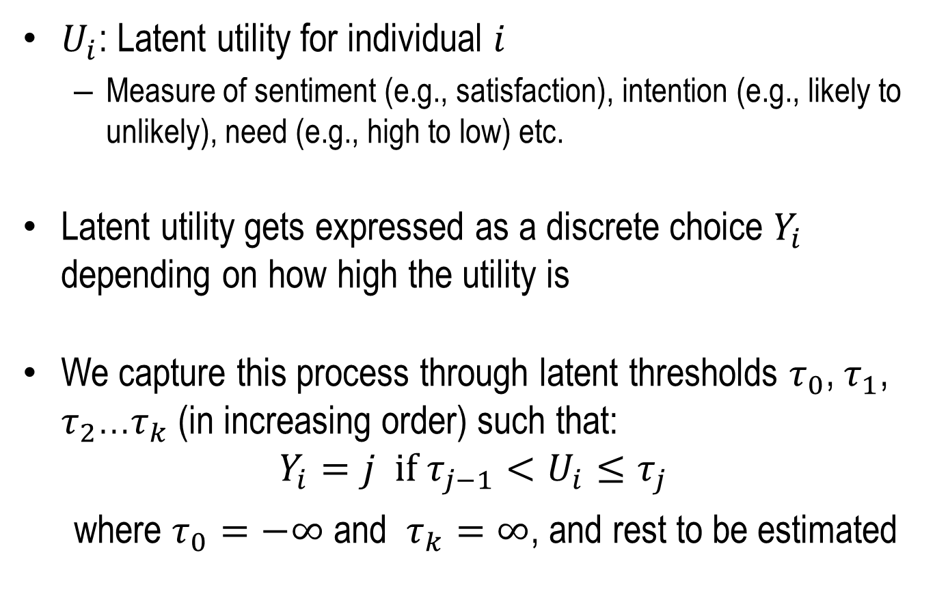
Ordered Logit Model Formulation
$U_{i}$: Latent utility for individual $i$
Measure of sentiment (e.g., satisfaction), intention (e.g., likely to unlikely), need (e.g., high to low) etc.
Latent utility gets expressed as a discrete choice $Y_{i}$ depending on how high the utility is
We capture this process through latent thresholds $τ_{0}$, $τ_{1}$, $τ_{2}$…$τ_{k}$ (in increasing order) such that:
$$Y_{i}=j if τ_{j−1}<U_{i}≤τ_{j}$$
where $τ_{0}=−∞$ and $τ_{k}=∞$, and rest to be estimated

Slide 36








Visual Representation
$$Y_{i}=1$$
$$Y_{i}=2$$
$$…$$
$$Y_{i}=k$$
$$τ_{1}$$
$$τ_{2}$$
$$τ_{k−1}$$
$$U_{i}$$

Slide 37
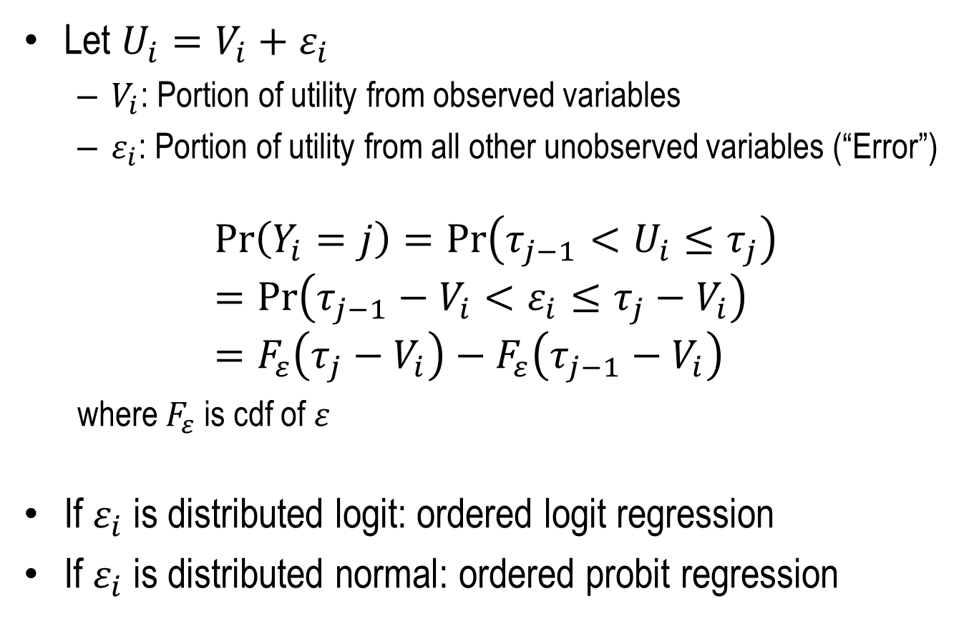
Ordered Logit Model Formulation
Let $U_{i}=V_{i}+ε_{i}$
$V_{i}$: Portion of utility from observed variables
$ε_{i}$: Portion of utility from all other unobserved variables (“Error”)
$$\operatorname{Pr}\left(Y_{i}=j\right)=\operatorname{Pr}\left(τ_{j−1}<U_{i}≤τ_{j}\right)=\operatorname{Pr}\left(τ_{j−1}−V_{i}<ε_{i}≤τ_{j}−V_{i}\right)=F_{ε}\left(τ_{j}−V_{i}\right)−F_{ε}\left(τ_{j−1}−V_{i}\right)$$
where $F_{ε}$ is cdf of $ε$
If $ε_{i}$ is distributed logit: ordered logit regression
If $ε_{i}$ is distributed normal: ordered probit regression

Slide 38
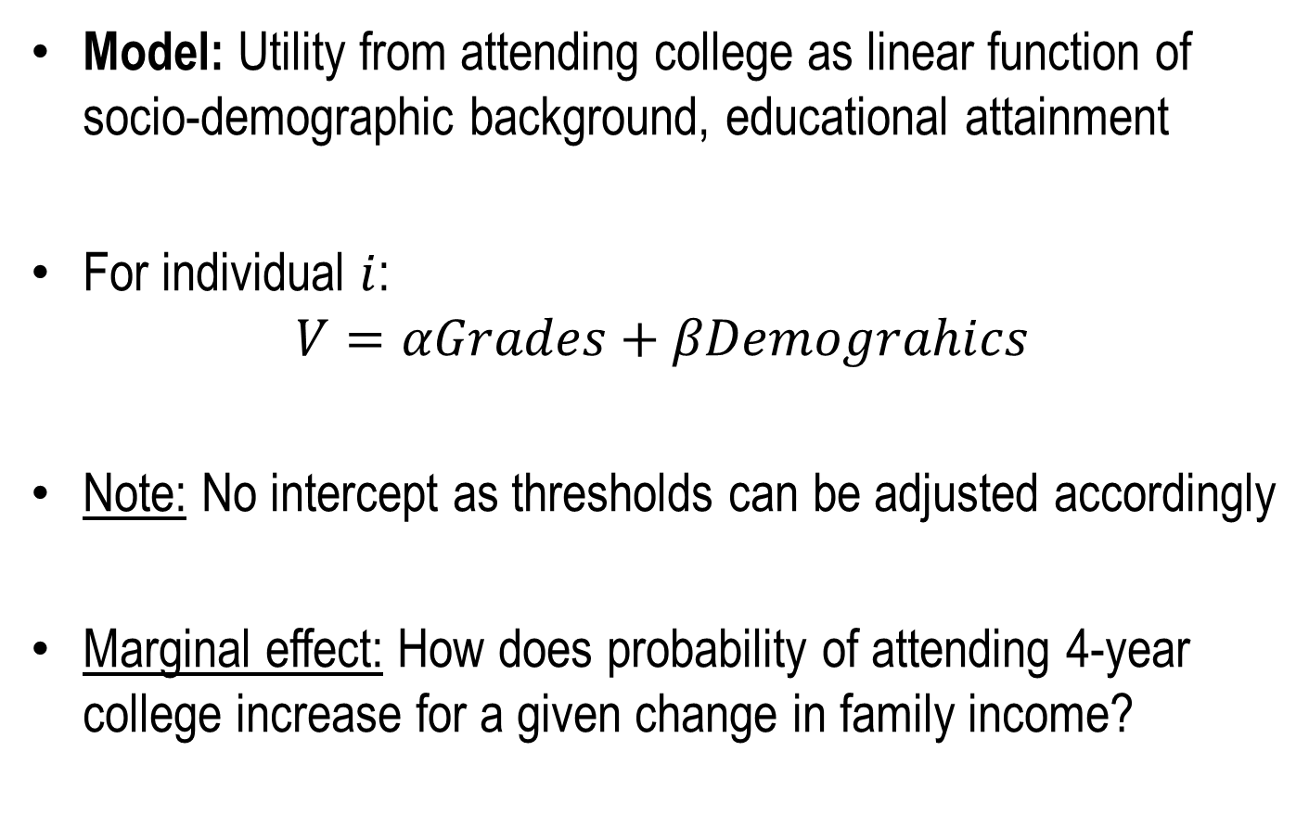
School Choice Example
Model: Utility from attending college as linear function of socio-demographic background, educational attainment
For individual $i$:
$$V=αGrades+βDemograhics$$
Note: No intercept as thresholds can be adjusted accordingly
Marginal effect: How does probability of attending 4-year college increase for a given change in family income?

Slide 39


School Choice Example (Logit)
Parameter |  | DF | Estimate | Standard Error | Wald Chi-Sq | Pr > ChiSq
Intercept | 1 | 1 | -4.3608 | 0.3817 | 130.5041 | <.0001
Intercept | 2 | 1 | -2.8222 | 0.3647 | 59.8836 | <.0001
grades |  | 1 | 0.4991 | 0.0368 | 184.2882 | <.0001
hscath |  | 1 | -14.2904 | 405.7 | 0.0012 | 0.9719
faminc |  | 1 | -0.00975 | 0.00246 | 15.7416 | <.0001
famsiz |  | 1 | 0.0347 | 0.0510 | 0.4637 | 0.4959
parcoll |  | 1 | -0.6653 | 0.1760 | 14.2871 | 0.0002
female |  | 1 | 0.0788 | 0.1366 | 0.3325 | 0.5642
black |  | 1 | -1.1218 | 0.2985 | 14.1218 | 0.0002
$$τ_{1}$$
$$τ_{2}$$

Slide 40
School Choice Example (Probit)
Parameter |  | DF | Estimate | Standard Error | Wald Chi-Sq | Pr > ChiSq
Intercept | 1 | 1 | -2.6161 | 0.2179 | 144.2107 | <.0001
Intercept | 2 | 1 | -1.7075 | 0.2109 | 65.5427 | <.0001
grades |  | 1 | 0.2962 | 0.0207 | 205.0926 | <.0001
hscath |  | 1 | -4.8399 | 94.0886 | 0.0026 | 0.9590
faminc |  | 1 | -0.00496 | 0.00135 | 13.4379 | 0.0002
famsiz |  | 1 | 0.0209 | 0.0303 | 0.4746 | 0.4909
parcoll |  | 1 | -0.4073 | 0.1022 | 15.8893 | <.0001
female |  | 1 | 0.0365 | 0.0808 | 0.2037 | 0.6517
black |  | 1 | -0.6597 | 0.1774 | 13.8352 | 0.0002
$$τ_{1}$$
$$τ_{2}$$

Slide 41
Multiclass Classification
Dr. Upender Subramanian
MKT/BUAN 6337

Slide 42
Classification
Multinomial models make prediction about probability of each outcome
Classify based on outcome with highest predicted probability
Challenge: How to tune classification based on incidence rates, false positive and false negative costs?
Transform k-1 predicted probabilities to a classification
Note: False positive and false negative costs can depend on which alternative was misclassified as what

Slide 43
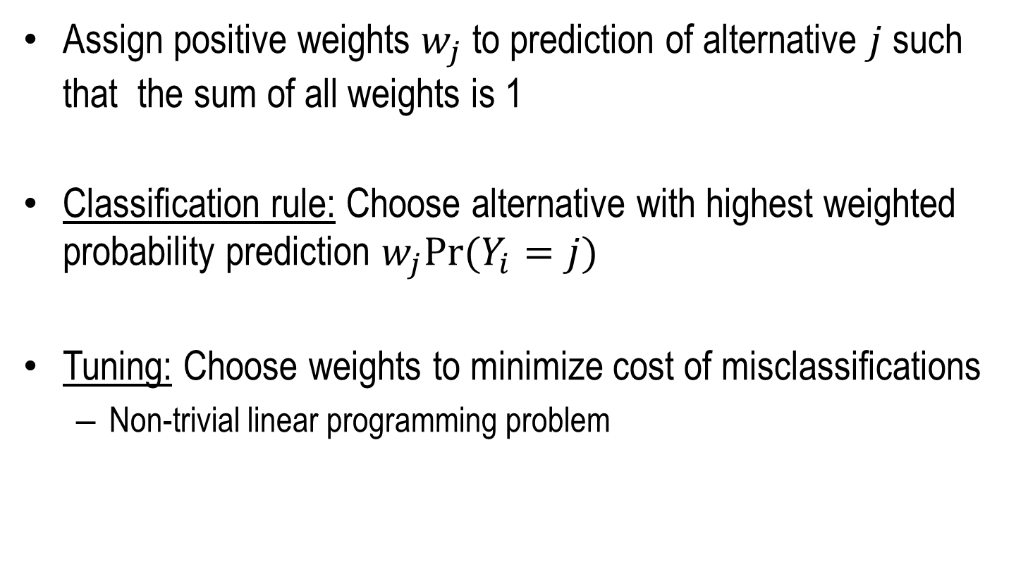
Classification
Assign positive weights $w_{j}$ to prediction of alternative $j$ such that the sum of all weights is 1
Classification rule: Choose alternative with highest weighted probability prediction $w_{j}Pr⁡(Y_{i}=j)$
Tuning: Choose weights to minimize cost of misclassifications
Non-trivial linear programming problem

